Slide 1

Microsoft Machine Learning Service
Shijun Liu
Microsoft Commercial Software Engineering
shliup@microsoft.com

Slide 2
Machine Learning Services
PaaS
Machine Learning Studio
UI based ML module drag-draw tool
No coding
Machine Learning Workbench
E2E ML tool from experimentation to operationalization
Full life-cycle IDE
IaaS
Data Science Virtual Machine
Virtual Machine with pre-installed
ML package
Fully customized
On-
premises
Machine Learning Server
in SQL Server
SQL preference
Python and R engine in SQL Server
Platform
Preference

Slide 3
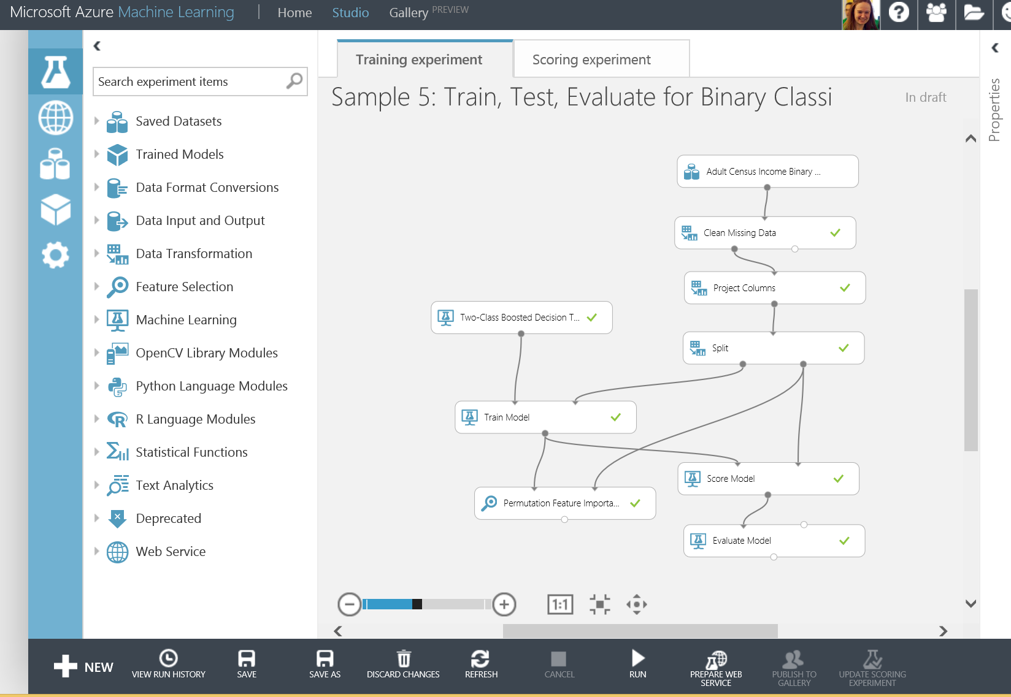
Azure Machine Learning Studio
GUI based，integrated development environment on Azure, to build and operate Machine Learning workflow
Visit through browser
Visual E2E module to form dataflow
>100 ML algorithms and model library
R and Python extensions
Quick deployment as Web API and auto-scaling

Slide 4
Azure Machine Learning Studio
Data
Client
API
ML STUDIO
Callable Web API
Blobs and Tables
Hadoop (HDInsight)
Relational DB (Azure SQL DB)
ML development environment

Slide 5
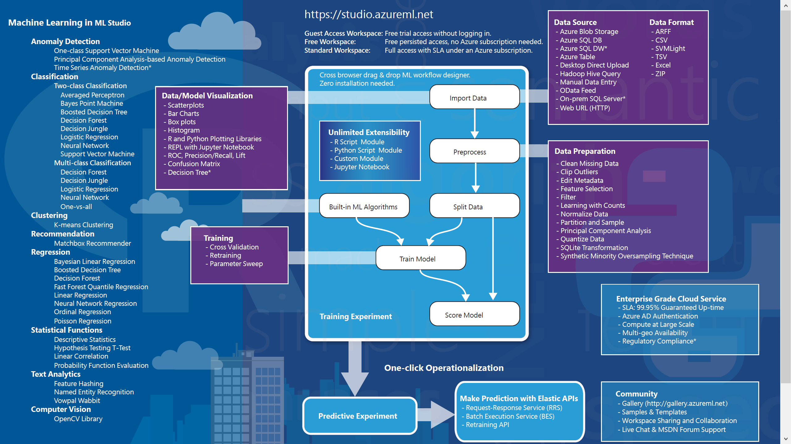
AML能力
Credit risk
- DocumentDB
Diabetes
User
Profile
Sales
Detect Languages
Extract Key Phases from Texts
Extract N-grams Features
Latent Dirichlet Allocation
Notes:
Matchbox: Bayesian method

Slide 6
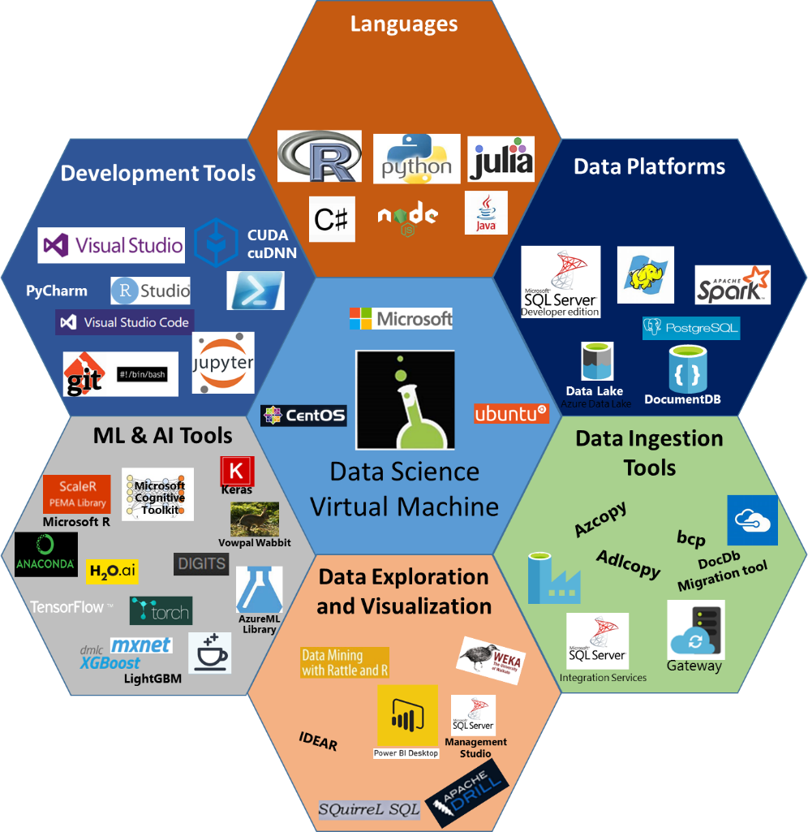
Data Science VM
Comprehensive cloud based Data Science Environment to empower Data Scientists

Slide 7
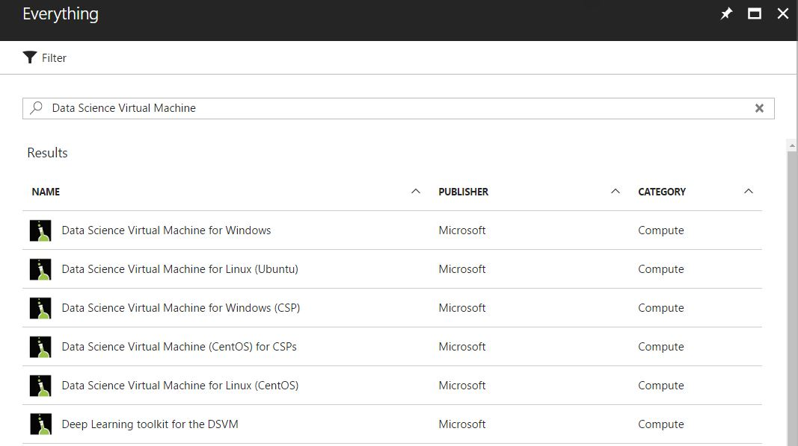
Azure Data Science VM
Support Multi-OS
CentOS\Ubuntu
Windows Server 2012/2016

Slide 8
Azure Data Science VM
Pre-installed and configure multiple ML runtime and tools:
CNTK, TensorFlow, MXNet, Caffe, DIGITS, H2O, Keras, Theano, Torch, OpenCV
NVIDIA driver, CUDA, and cuDNN
Microsoft R Server 9.0 with Microsoft R Open 3.3.2
Anaconda Python 2.7 and 3.5
JupyterHub with sample notebooks
Apache Drill for querying non-relational data using SQL
Spark local 2.0.2 with PySpark and SparkR Jupyter kernels
Single node local Hadoop (HDFS, Yarn)
Azure command-line interface
Visual Studio Code, IntelliJ IDEA, PyCharm, Atom
JuliaPro, a curated distribution of Julia Language and tools
Vowpal Wabbit for online learning
xgboost for gradient boosting

Slide 9
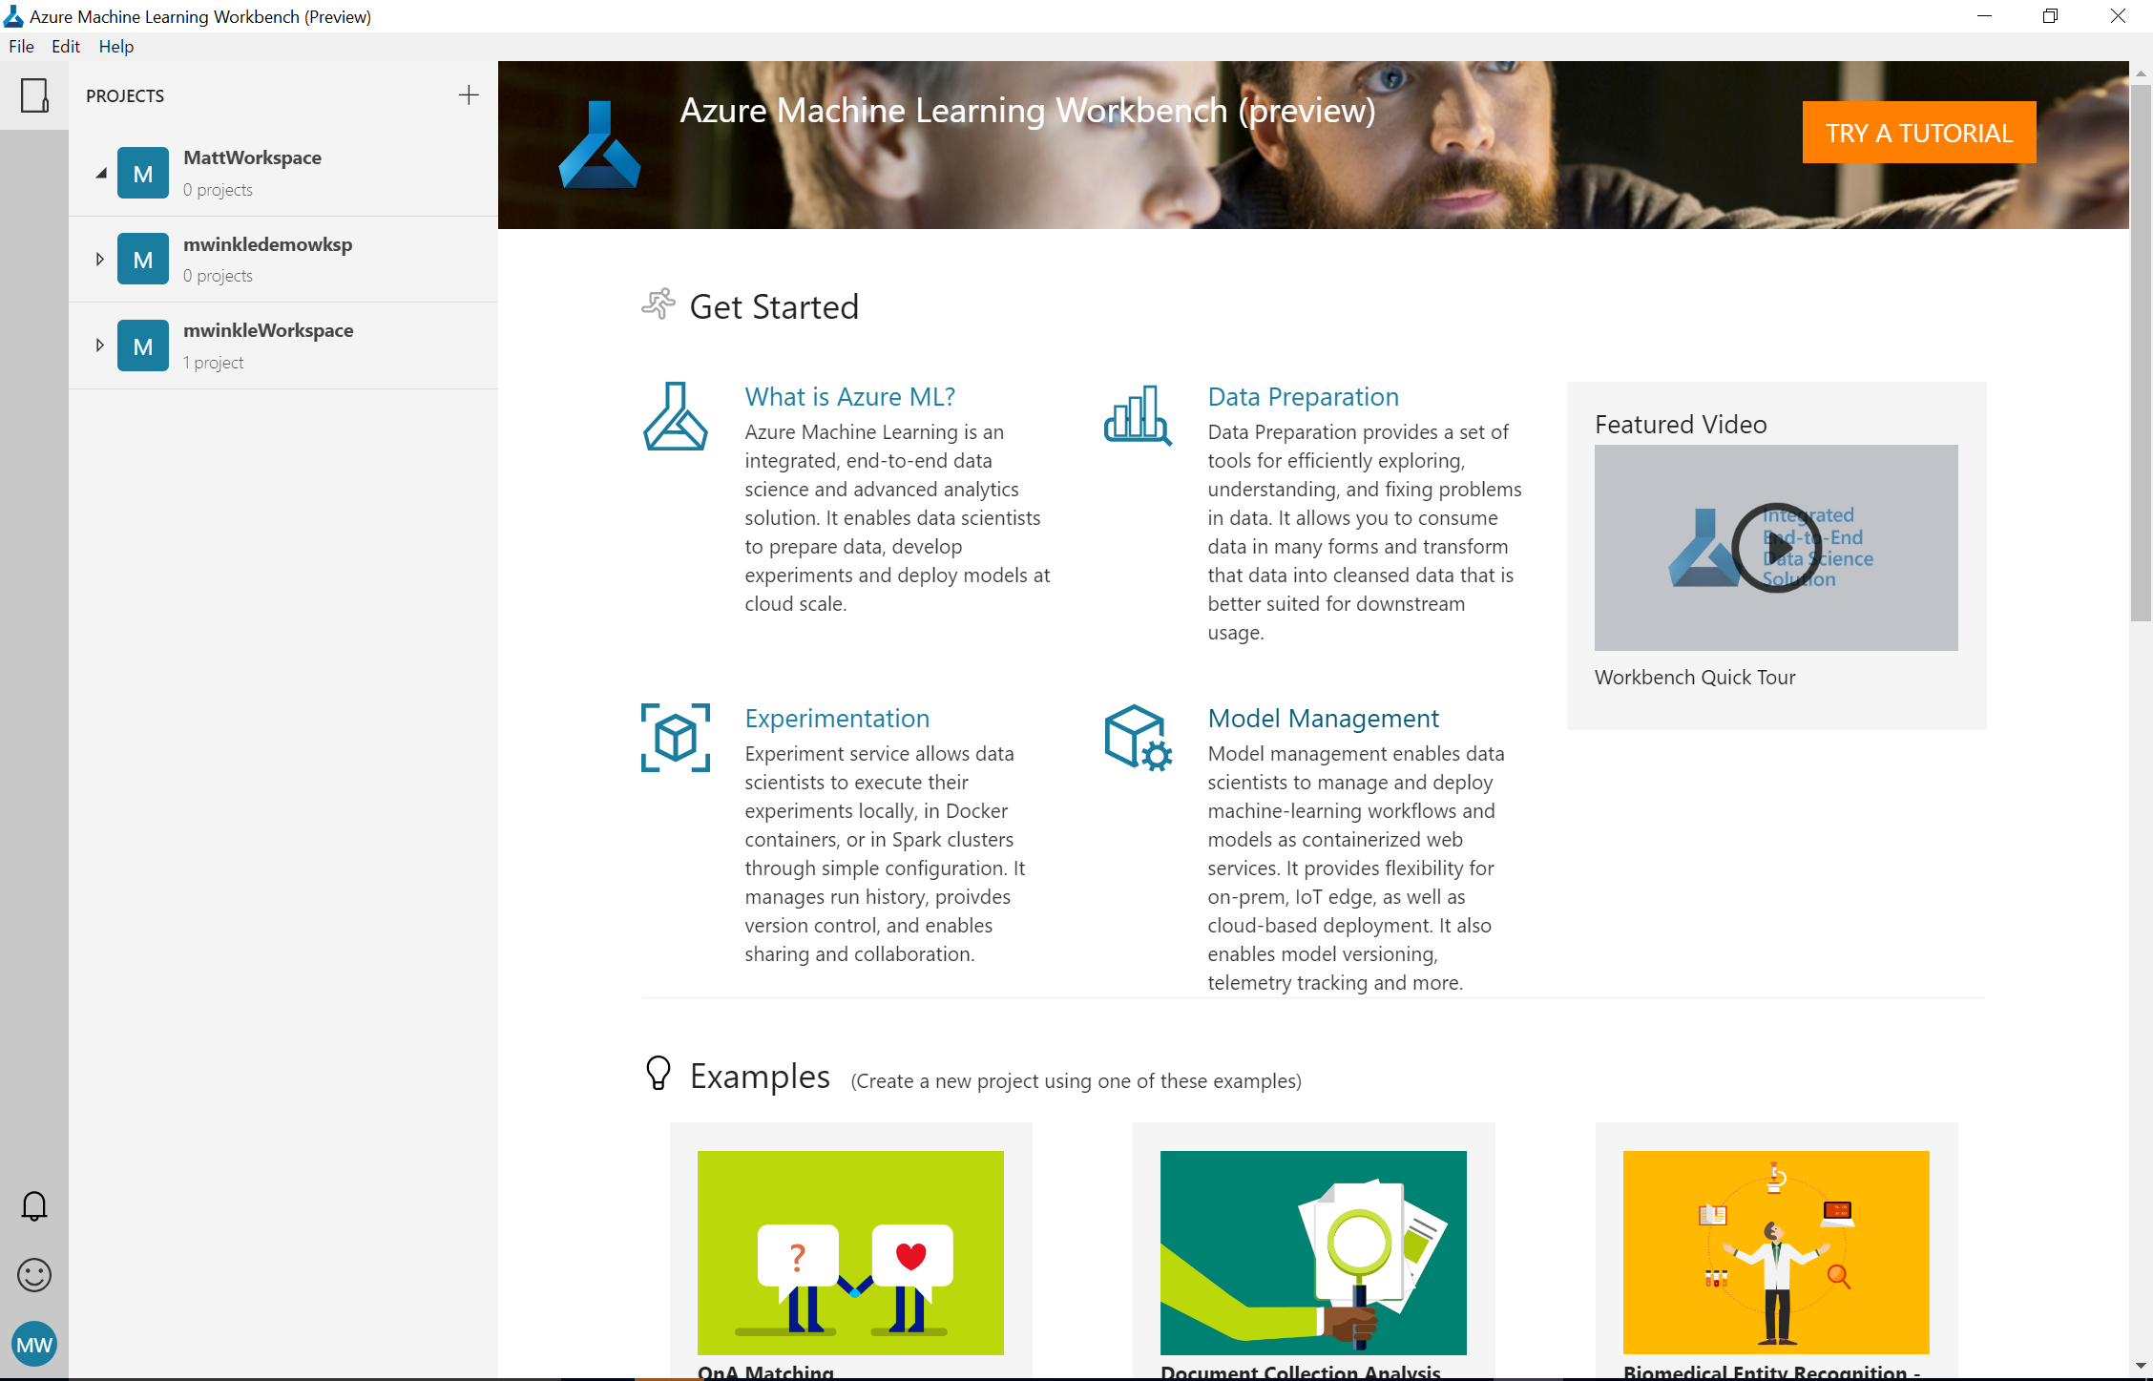
Azure Machine Learning Workbench
Windows and Mac based companion for AI development
Full environment set up (Python, Jupyter, etc)
Embedded notebooks
Run History and Comparison experience
New data wrangling tools

Slide 10
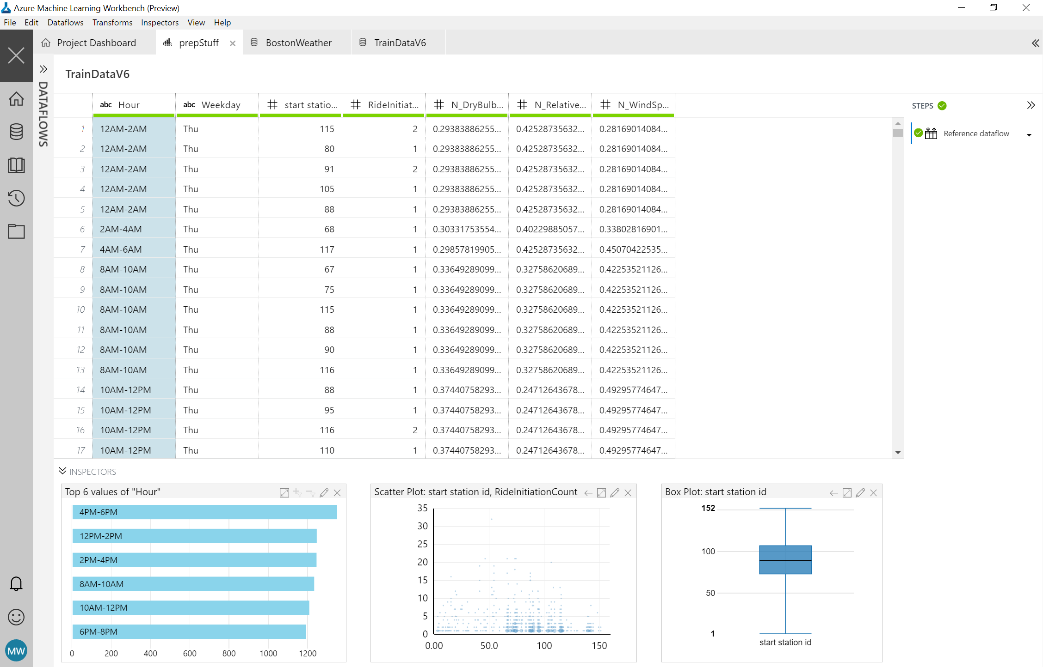
AI Powered Data Wrangling
Rapidly sample, understand, and prep data
Leverage PROSE and more for intelligent, data prep by example
Extend/customize transforms and featurization through Python
Generate Python and Pyspark for execution at scale

Slide 11

Experiment Everywhere
Local machine
Scale up to DSVM
Command line tools
Scale out with Spark on HDInsight
IDEs
Notebooks in Workbench
AZURE ML
EXPERIMENTATION
VS Code Tools for AI
Azure Batch AI (Coming Soon)
ML Server

Slide 12
Deploy Everywhere
Single node deployment (cloud/on-prem)
Azure Container Service
Azure IoT Edge
AZURE ML
MODEL MANAGEMENT
DOCKER
Microsoft ML Server
Spark clusters
SQL Server

Slide 13
SQL Server Machine Learning Services
SQL Server 2016
R support (3.2.2 version)
SQL Server 2017
Native scoring using PREDICT function (+Linux support)
EXTERNAL LIBRARY DDL for R package management
Batch mode execution support for input data
R support (3.3.3 version)
Python support (Anaconda 3.5.2)

Slide 14
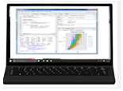
Data Scientists - Data Exploration and Model Development
train <- RxSqlServerData(query, connectionString, computeContext)
rxLogit(formula, train)
2
Execution
1
Script
Data Scientist Workstation
SQL Server
3
Results
Machine Learning Services
Any R/Python IDE
R/Python Runtime

Slide 15
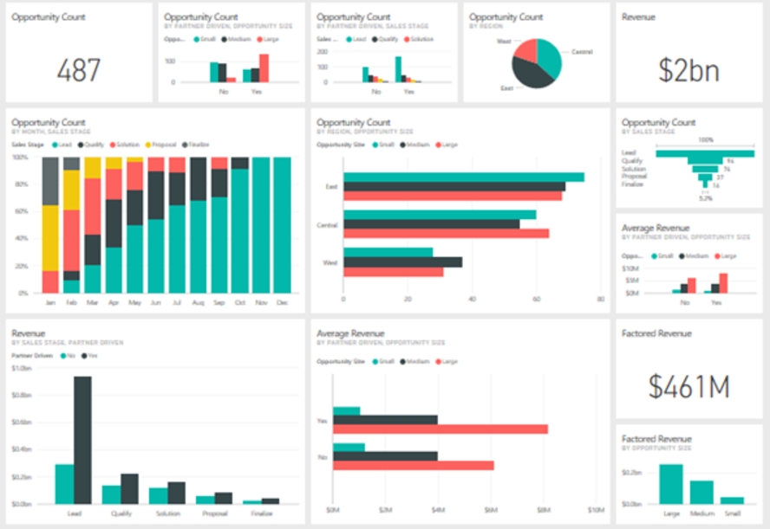
Application Developer - Model Operationalization
2
Execution
1
Stored Proc call
The stored procedure contains R or Python code and executes in-database
SQL Server
3
Results
Application
Machine Learning Services
exec sp_execute_external_script
@language = ‘Python’
, @script =
-- Python code --
R/Python Runtime

Slide 16
Machine Learning & AI Portfolio When to use what?
Microsoft ML & AI products
Build your own or consume pre-trained models?
Build your own
Consume
Azure Machine Learning
Cognitive services, bots
Which experience do you want?
Code first
Visual tooling
Deployment target
(On-prem) SQL Server
(cloud)
AML Workbench
(cloud)
AML Studio
What engine(s) do you want to use?
SQL Server
Spark
Hadoop
Azure Batch
DSVM
Azure Container Service

